Slide 1
Lesson 7
Word Problems with Quadratic Functions

Slide 2
Recap on What we Learnt so Far:
The vertex is for finding the Max/Minimum of something
The x-intercepts is when the height is zero
The y-intercept is when t=0 or x=0, height at the beginning
The axis of symmetry is the x-value or the time when an object is at the vertex (highest point) or lowest point
General form:
APQ Form:
Vertex:
A.O.S.
Axis of Symmetry
Plug this value into the equation to find the “y-value” for the vertex
Y-int:
X-int:

Slide 3
applications of Quadratic Functions:
There are many applications of quadratic functions, anything that has to do with maximizing or minimizing a value
Finance and Business:
  Ie: Maximize Revenue and Profit
Construction and Infrastructure
  Maximize the area of a park, building, room
Coding and Programming
  Maximize efficiency: minimize the amount of resources to perform a task
In general, you will have two equations, plug one equation into the other to make a quadratic function
The quadratic function will be used the find the maximum or minimum of something: area, product,
Use CTS or XAV or -b/2a to find the vertex

Slide 4
II) Common terms:
Sum → Add , sum of two numbers is 10
Difference → Subtract, the diff. of two numbers is 8
Product → Multiply, the product of two numbers is a maximum value
Sum of their squares → Square the numbers & then add them, the sum of their squares is a minimum
Perimeter → length of all the edges, the perimeter of a rectangle is 200m
© Copyright all rights reserved to Homework depot: www.BCMath.ca

Slide 5
Ex: The sum of two numbers is 80. Their product is 1500. Find the numbers
i) Write an expression for the two values
ii) Write an expression for the product
iii) Find the two numbers
iv) Suppose the product is a different value. What is the largest product that is possible?

Slide 6
Ex: The sum of two numbers is 80. Their product is 1500. Find the numbers
There are two numbers, let ‘x’ and
’80 –x’ be the numbers
Gather Information
80 minus the first number gives you the second nunber
The product is 1500
The two numbers are 30 and 80

Slide 7
d) Suppose we are looking for the largest possible product, use the product equation to find the vertex
So, if you have two values with a difference of 80, the largest product that you can have is 1600
The maximum product will occur if one of the values is 40

Slide 8
Ex: The difference of two numbers is 10. The sum of their squares is 60. Find the numbers
a) Find an expression for the two numbers
b) Write an equation for the sum of their squares
c) Find the two numbers
d) Suppose the sum of their squares is not 60. What is the smallest possible value for the sum of their squares?

Slide 9
Ex: The difference of two numbers is 10. The sum of their squares is 60. Find the numbers
The second number is 10
more than the first
Gather Information
The sum of their squares is 60
The two sets of numbers are:

Slide 10
d) Suppose the sum of their squares is not 60. What is the smallest possible value for the sum of their squares?
Since we are looking for the smallest possible sum, find the vertex then
If two numbers have a difference of 10, the smallest possible sum of their squares is 50
The minimum sum will occur if one of the values is -5

Slide 11
Ex: The height, “h” metres, of an infield fly ball “t” seconds after being hit is given by simplified formula : h = 30t – 5t². a) What is the height of the ball after 4 seconds? b) How long after being hit is the ball at a height of 18 m? c) When will the ball reach it’s maximum height?
D) what is the maximum height?
E) When will the ball hit the ground?
F) What is the domain and range of this scenario?

Slide 13
Ex: The height, “h” metres, of an infield fly ball “t” seconds after being hit is given by simplified formula : h = 30t – 5t². How long after being hit is the ball at a height of 18 m?

Slide 14
Ex# A farmer wants to build a rectangular barn using 100 meters of fencing for his cows and chickens. However, he needs to separate the two groups of animals and needs to make the largest possible area. Determine the dimensions for the barn.
a) Draw a diagram showing how this barn would look like
b) Write an equation for the perimeter and the variables used to represent the length and width
c) Write an equation for the area of the barn
d) Determine the dimension of the barn and the maximum area
© Copyright all rights reserved to Homework depot: www.BCMath.ca

Slide 15
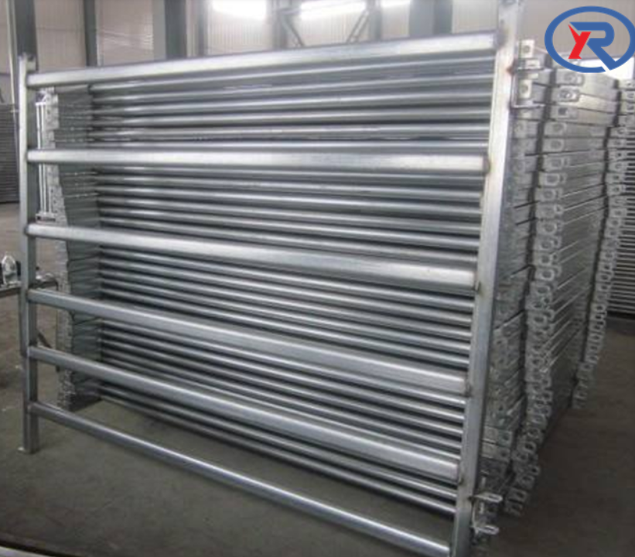
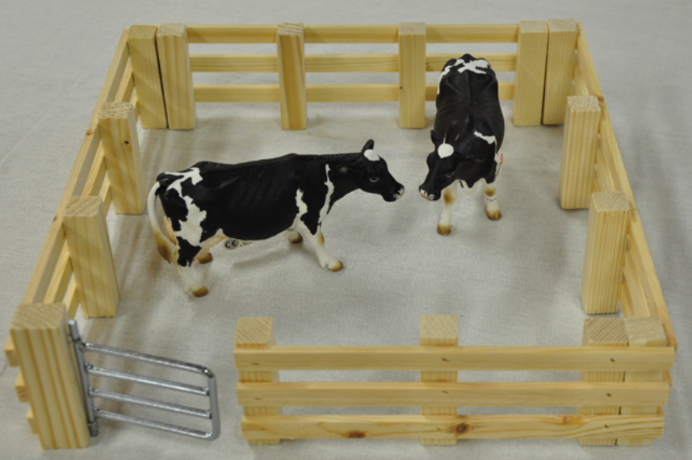
Ex#3) A farmer wants to build a rectangular barn using 100 meters of fencing for his cows and chickens. However, he needs to separate the two groups of animals and needs to make the largest possible area. Determine the dimensions for the barn.
Isolate one variable
Complete the square
© Copyright all rights reserved to Homework depot: www.BCMath.ca

Slide 16






practice: Suppose you have 400m of fencing to build a rectangular garden as illustrated below, what are the dimensions of the largest possible area?

Slide 17
Ex: A gardener would like to build a pathway of equal width around a rectangular garden measuring 8 meters by 15 meters. If this doubles the total area, then what is the width of the pathway?
x = –13.6912 is call
an extraneous root.

